Slide 1
Digitalization of Canteen Feedback System
Project Head: Mr. Senthil Kumar
Mr. Dhanamurgan
Team Members
Abinesh K
Alen Roi P
Selshiya Sherin M

Slide 2


Project Overview:
Scope:
Project Description:
Savings:
To build a user-friendly interface to collect the feedback and to resolve the problems effectively. This Model is combined with visualization which helps in analyzing the data.
Our objective is to get real time canteen feedback, view in depth reports, act and resolve issues quicker than ever before. Providing Graphical representation for better understanding (using Power BI).
No investment-Cost efficient. Man-hours and efforts are saved.
TimeLine
Requirement Definition | CW34
Technical Feasibility (Software) | CW35
Software readiness and initial coding | CW36
User interface implementation and validation | CW37
Finalization of the System | CW38
Improvement measures validation | CW39
Target:
Benefits:
Get real time customer feedback in web-based user interface. Analyzation and visualization of data using Excel, MS forms and Power BI .
Through this system, We can analyze the results and take prompt action quicker to improve the satisfaction workers.

Slide 3
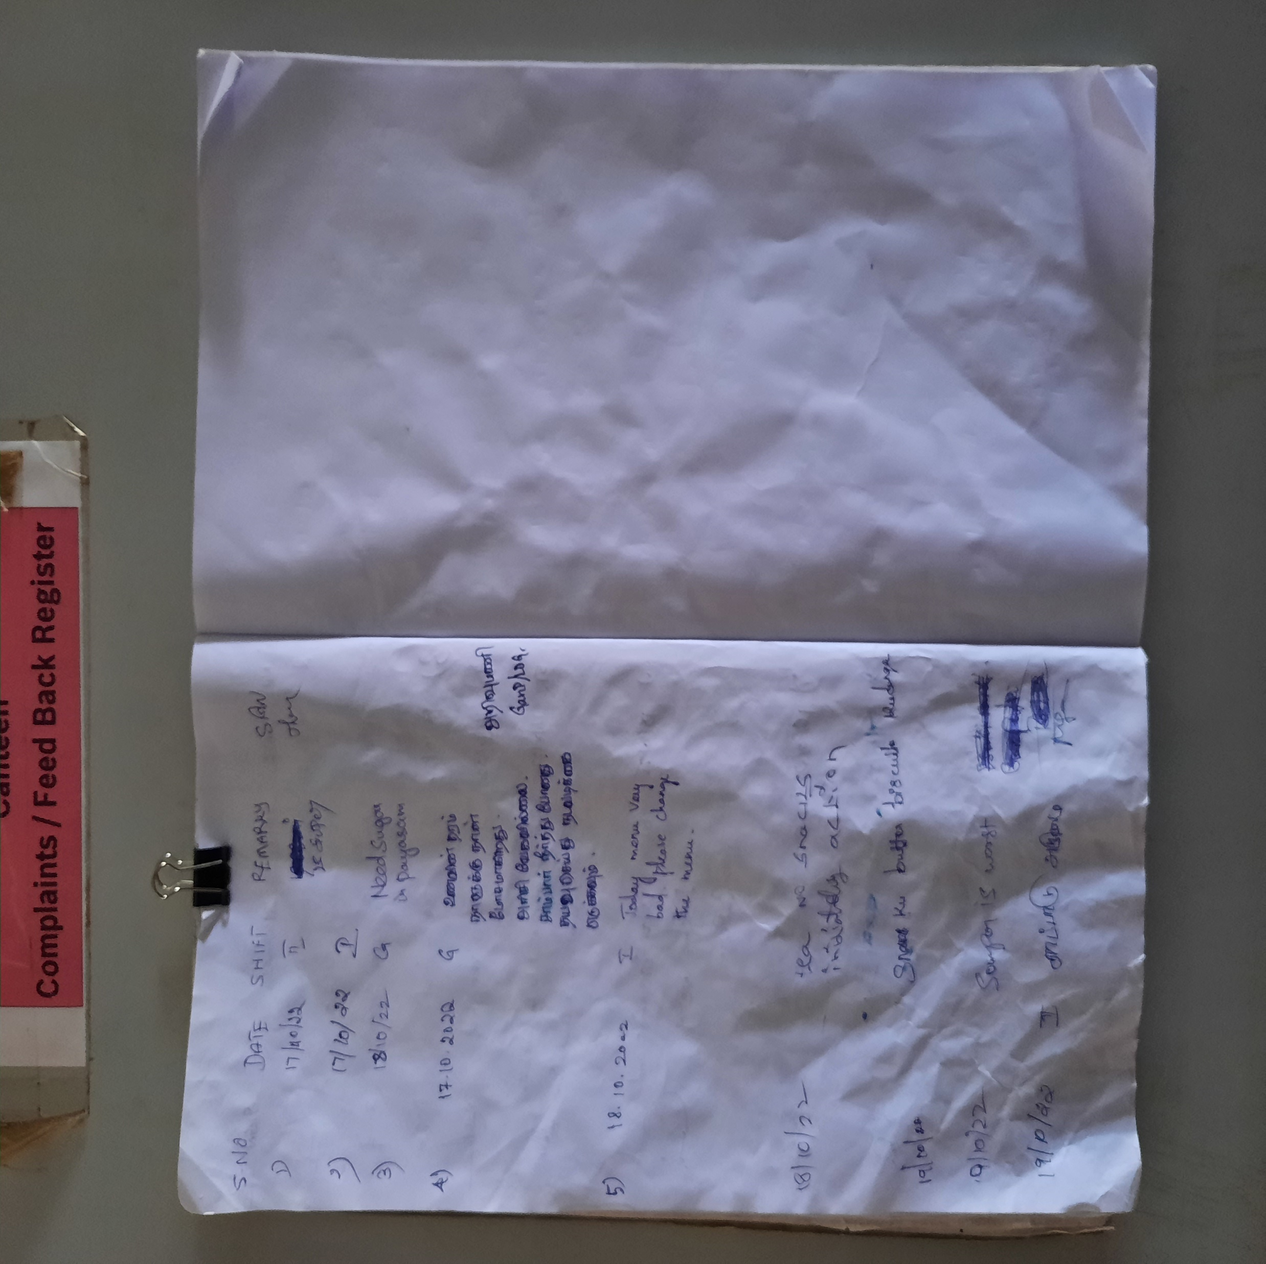
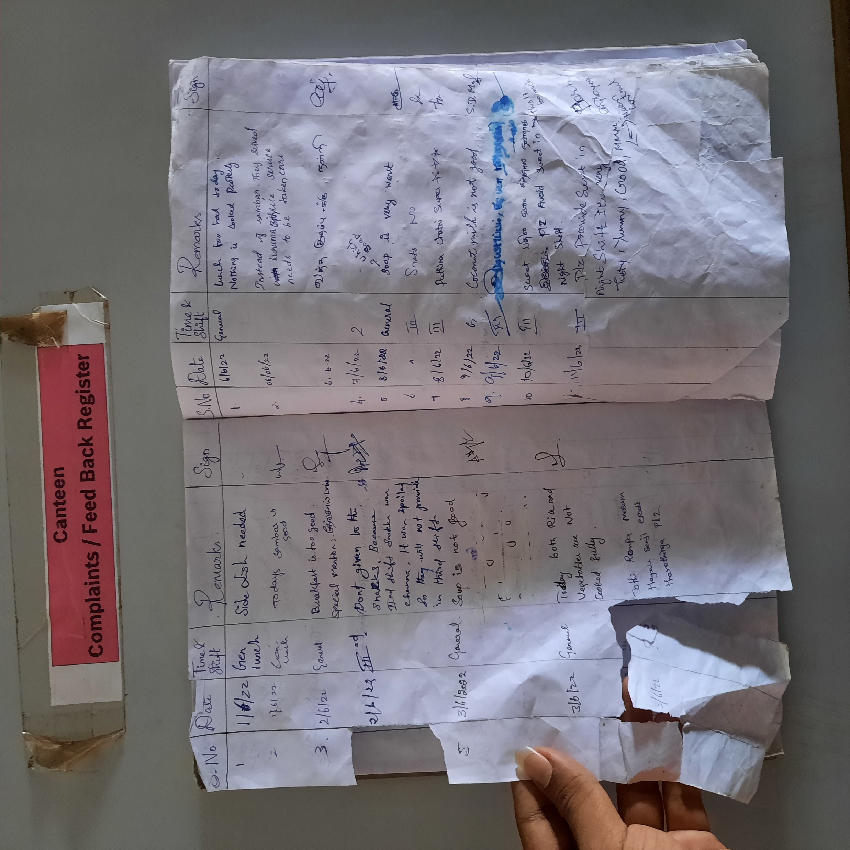
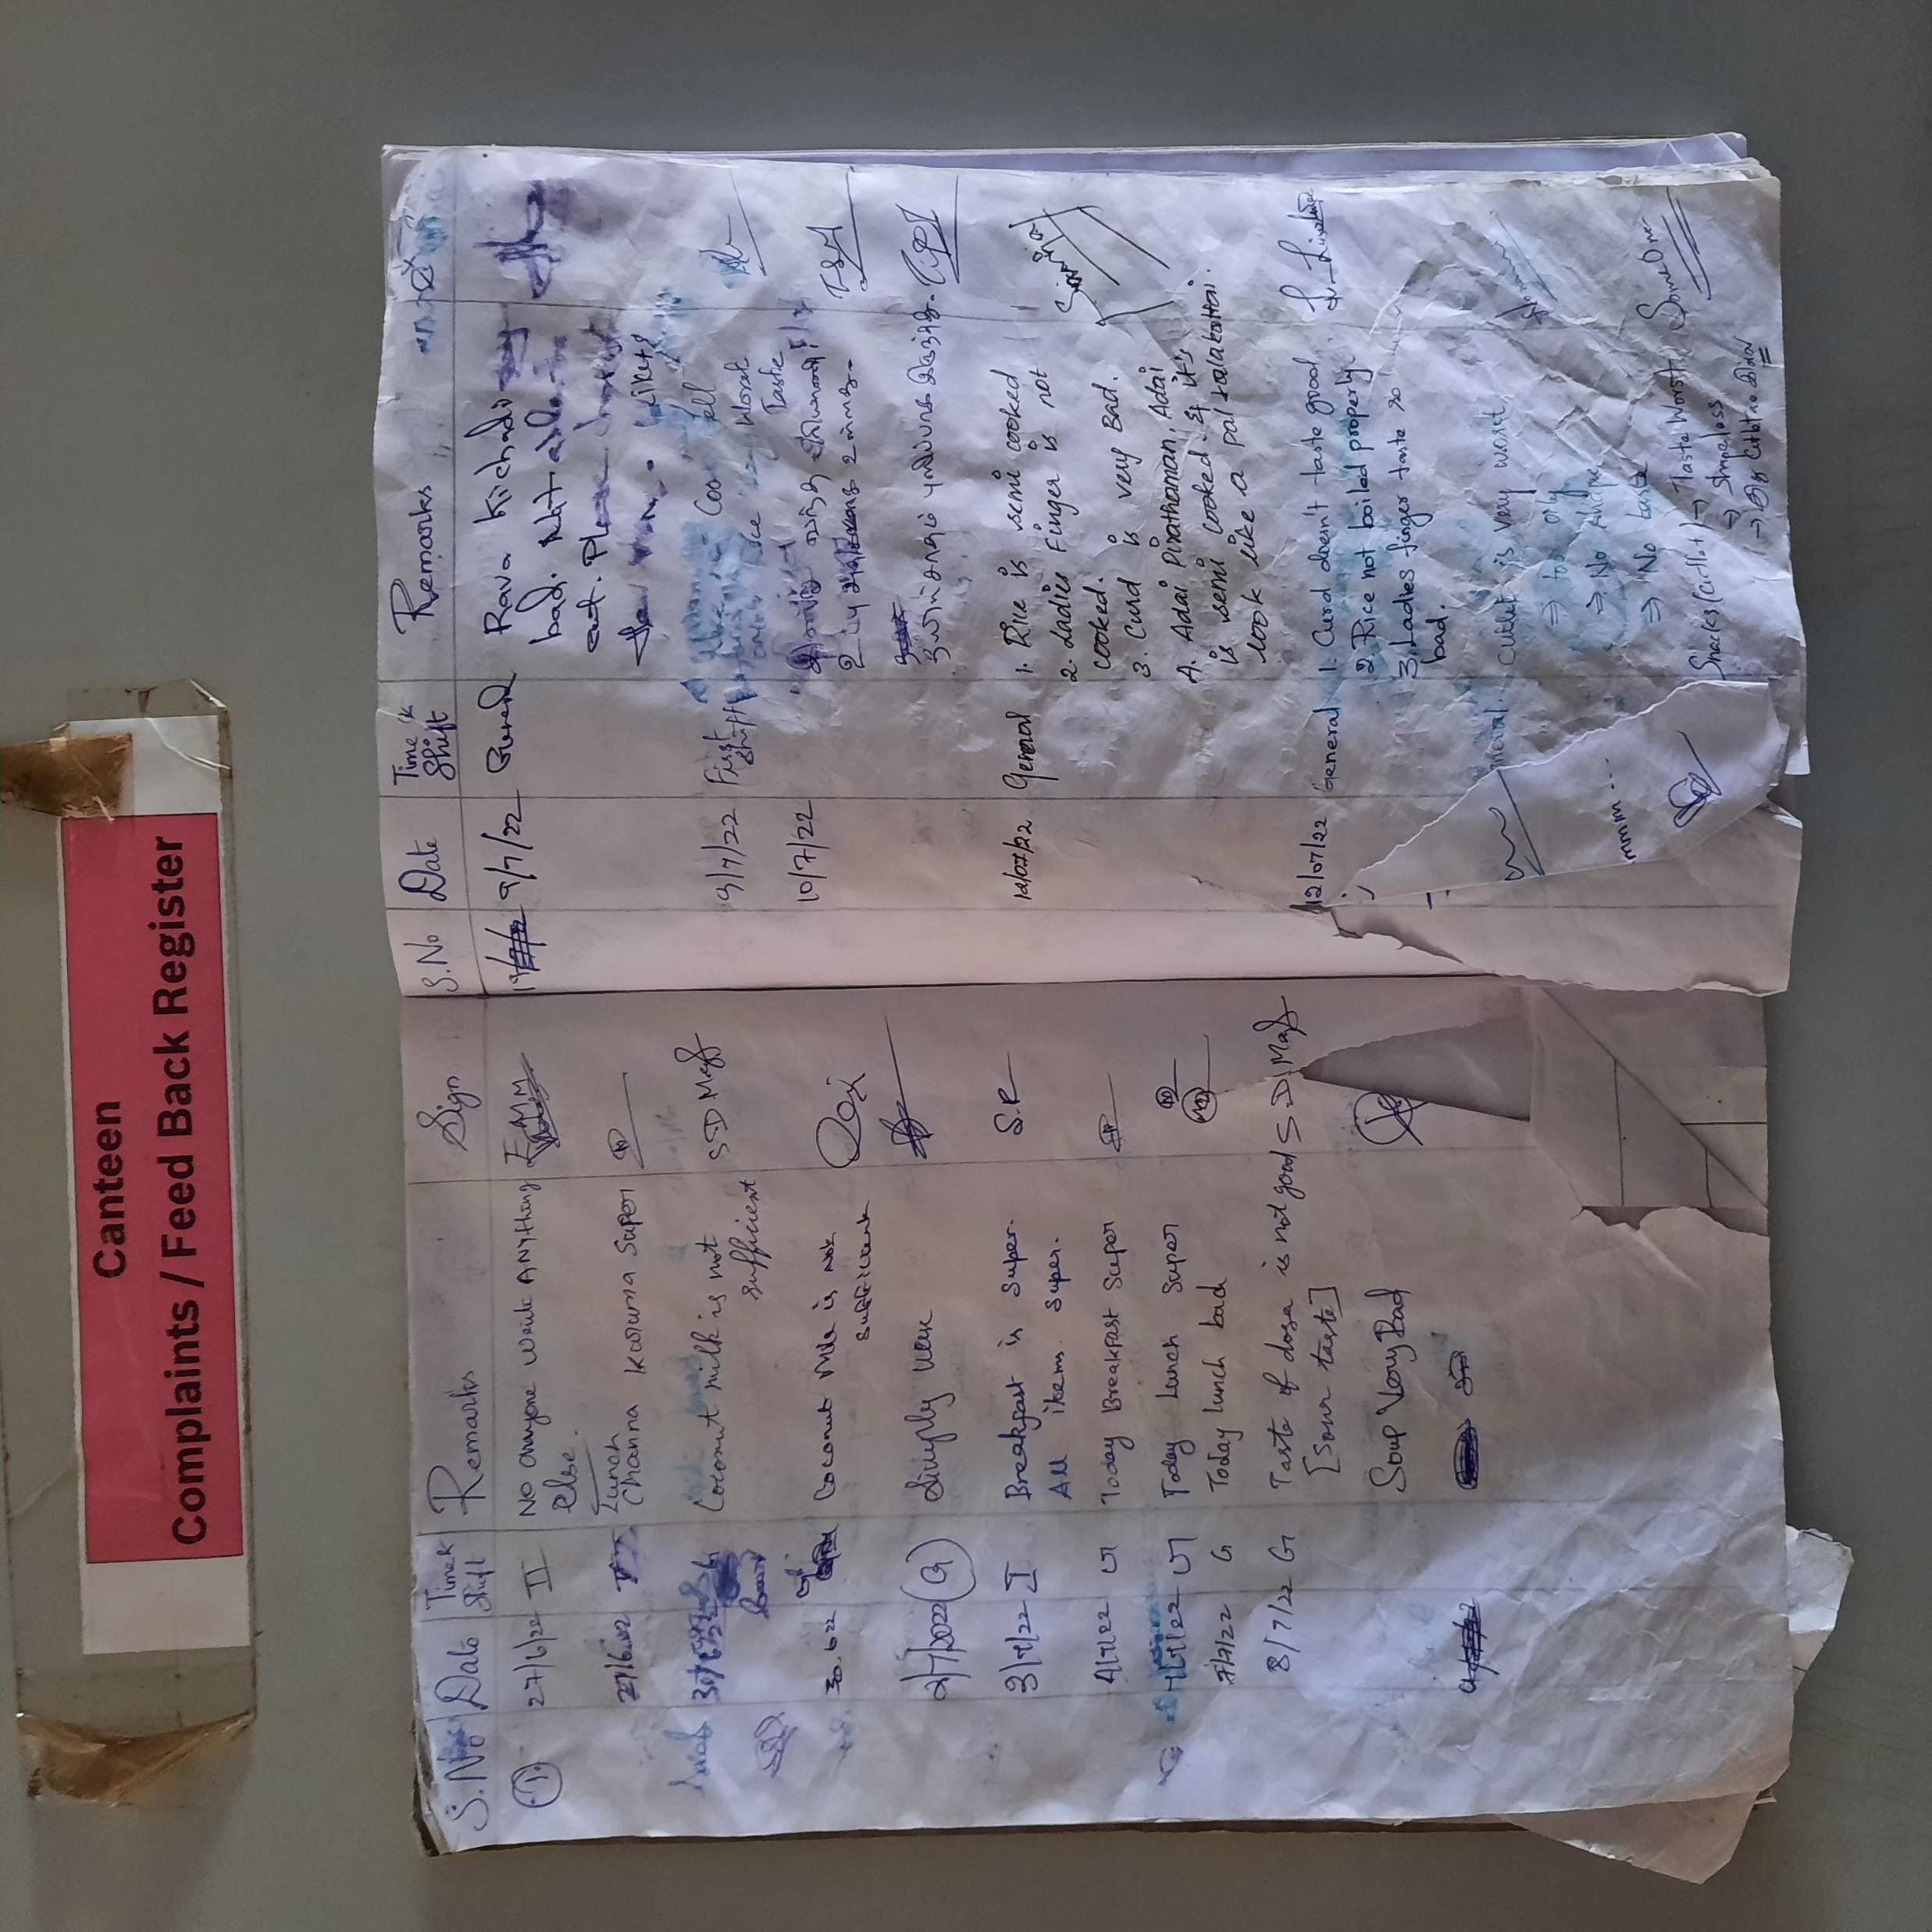
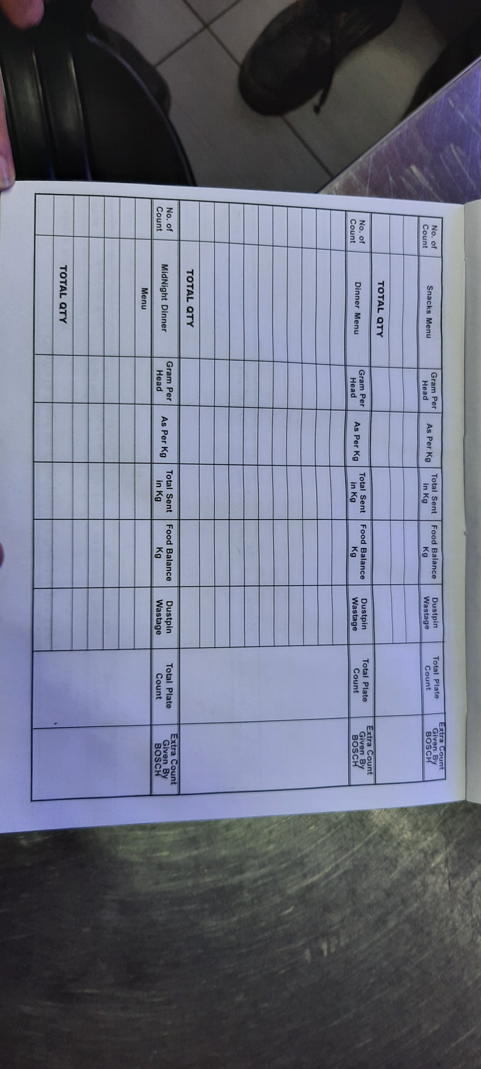
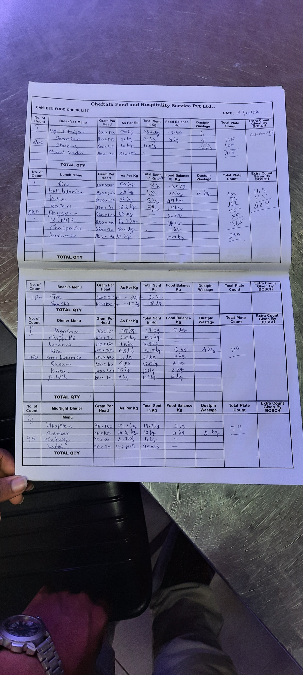
Existing System:
Low response rate. Finding difficulty in Maintenance of feedback Storage of response isn’t scalable and prone to damage. Time consuming. More Dependency of manual work. Finding difficulties in evaluation and analyzing the feedback. More time to analyze the data. Further actions cannot be done quickly. Can’t analyze the data over month or week wise.
Feedback is collected only in Notes(Hardcopy)
They are not maintained properly. Due to this there is a chance of the collected data be lost. Finding difficulties in evaluation and analyzing the feedback.
Waste Management System also done in manual process. There is a chance of data be lost. Prone to Damage.

Slide 4
Possible Solutions:
Outsourcing: There is numerous Feedback Management Solutions available in the Market like User Voice, Canny, etc. Advantages: Less Lead Time. Less Manpower. Collects and Analyze the feedback effectively. Disadvantages: High Cost. Chance of Data leakage due the usage of another Server It does not come under Bosch Security Standards. It does not satisfy the Required System’s requirements.
Web Forms: A web form is an online page that allows for user input. It is an interactive page that mimics a paper document or form, where users fill out fields. Advantages: Less Manpower and efforts. Less Lead Time. Collects and Analyze the feedback effectively. Provides Graphical representation (using Power BI). User friendly. Satisfies our requirements with the help of existing software. It comes under Bosch Security Standards No Investment.
Raspberry Pi The Raspberry Pi is a low cost, credit-card sized computer that plugs into a computer monitor or TV and uses a standard keyboard and mouse. Raspberry Pi has the ability to interact with the outside world. Advantages: Minicomputer, It can do same actions as a PC. Moderate cost. Disadvantages: To run this system network connection is needed but it is not possible due to insecure OS. Chance of Data leakage through server breakdown. It does not come under Bosch Security Standards.

Slide 5
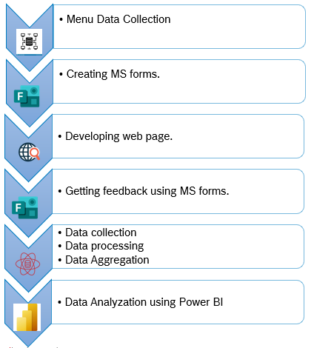
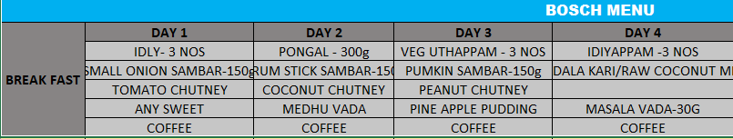
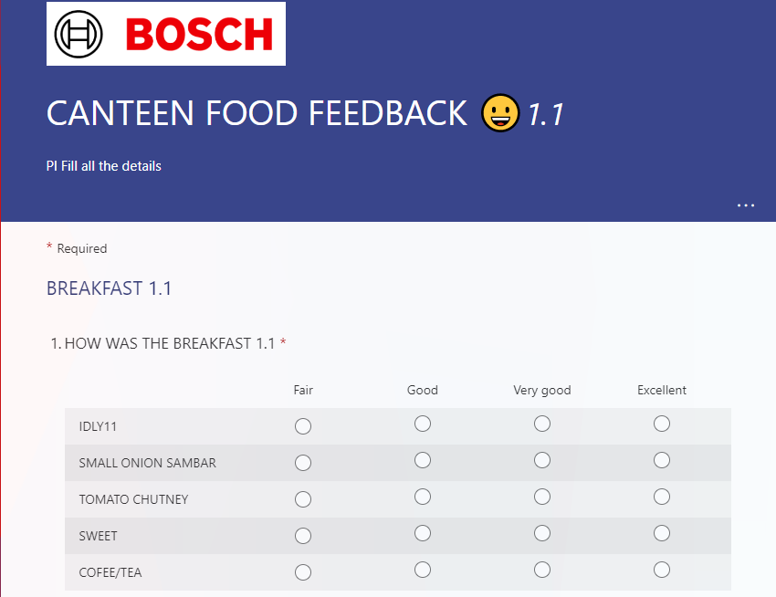
WEB FORMS’ WORKFLOW
Menu Data Collection:
Collected the Canteen Menu from the Canteen Committee.
Creating MS forms:
Microsoft Forms is a simple, lightweight tool that lets you quickly create a form, collect responses in real time and export the results to Excel for further analysis. We have created MS forms for the whole Menu that we have collected from the Canteen Committee.

Slide 6

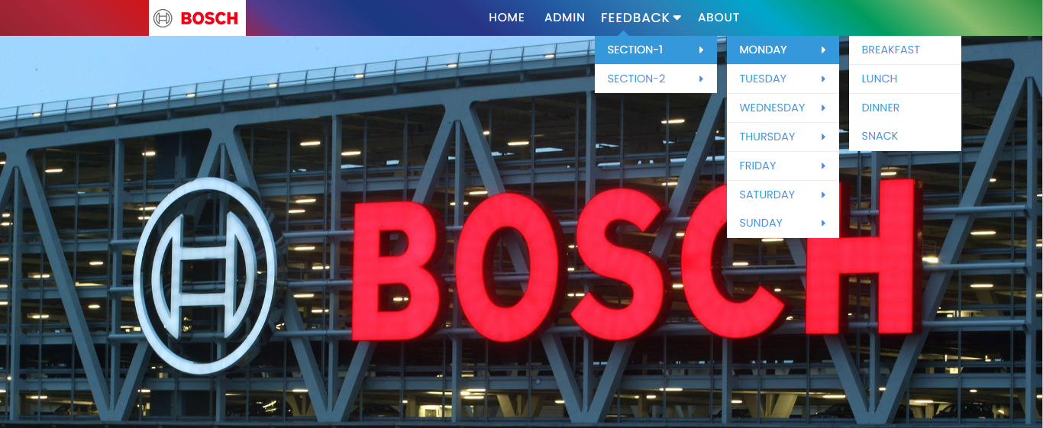
Developing web page:
Next, we have developed a Web page for getting the feedback. For creating a web page, we have used HTML,CSS as Frontend and Java Script as Backend. The web page consists of home page, Admin page, Feedback, about. The admin page consists of edit access for the created MS FORMS. If there is any change in the menu the supervisor will edit the forms using the edit access provided in the admin panel and it will be automatically updated in the corresponding forms. The feedback page consists of the forms that is to be published by the Supervisor to get the Feedback.

Slide 7
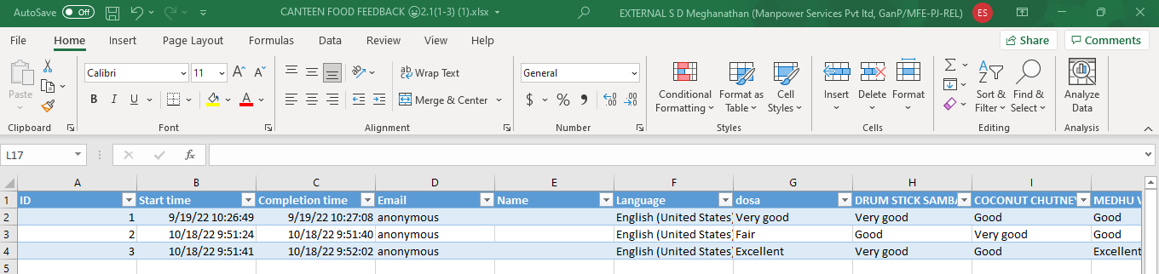
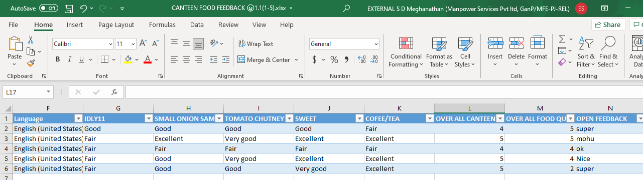
Data Collection:
Once the feedback is collected through the Web page, the next process called Data Collection starts over. We need to collect the data and export it in Excel Files. RAW DATA_1: RAW DATA_2:

Slide 8
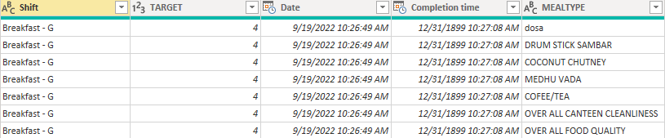
Data Processing:
As we have created individual forms for every single day of Menu, Data processing is very important process to do. This step involves replacing certain values, removing unwanted data, replacing values, splitting columns clearing table formats, using VLOOKUP formula to calculate the shift with respect to time. By using Power Query, we can transform the data (Unpivoting other columns) to get the desired data format. We got the desired Data format by Power Query

Slide 9
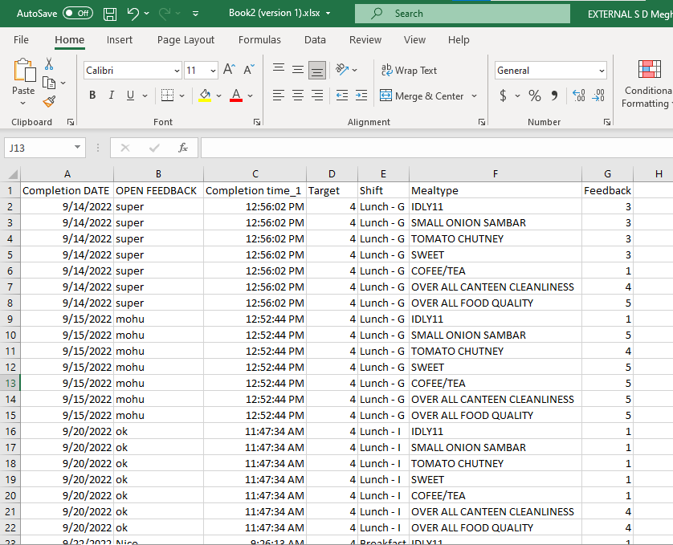
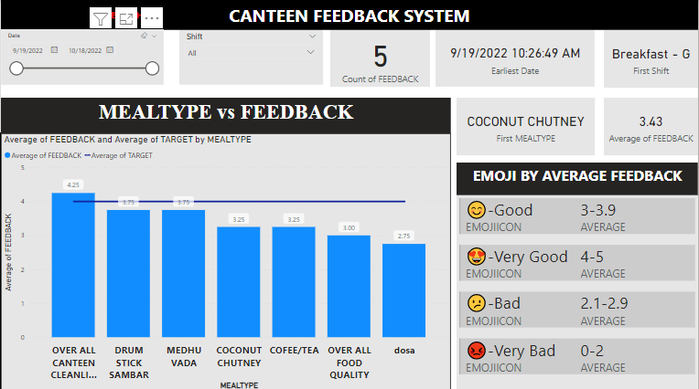
Data Aggregation:
Data Aggregation is a process of gathering the data from multiple sources and compiling, formatting, and processing the data further in a summarized form. It is used to analyze data statistically. After Data Processing is done, we need to aggregate all the data in a Single Excel file (Master file) ie copy paste all the contents that is in the power query to a single master excel file to load it to the Power BI. Repeat the same way of data processing for every single feedback file. .
Data Analyzation Using Power BI:
Power BI is a Data Visualization and Business Intelligence tool that converts data from different data sources such as Excel workbooks, SQL databases etc., to obtain Interactive Dashboards and BI reports. In our case we have our dataset in Excel workbook. We need to import the data and load it into the Power BI. Once it is done our data is ready for visualization. We have used the Line and Stacked Column Chart for viewing the results. We have provided the data range control and shift range as filters to filter the chart to see the desired result which makes the Power BI Report effective.

Slide 10
Results:

Slide 11
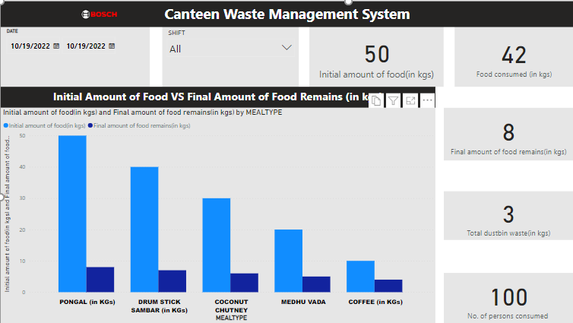
Results:

Slide 12
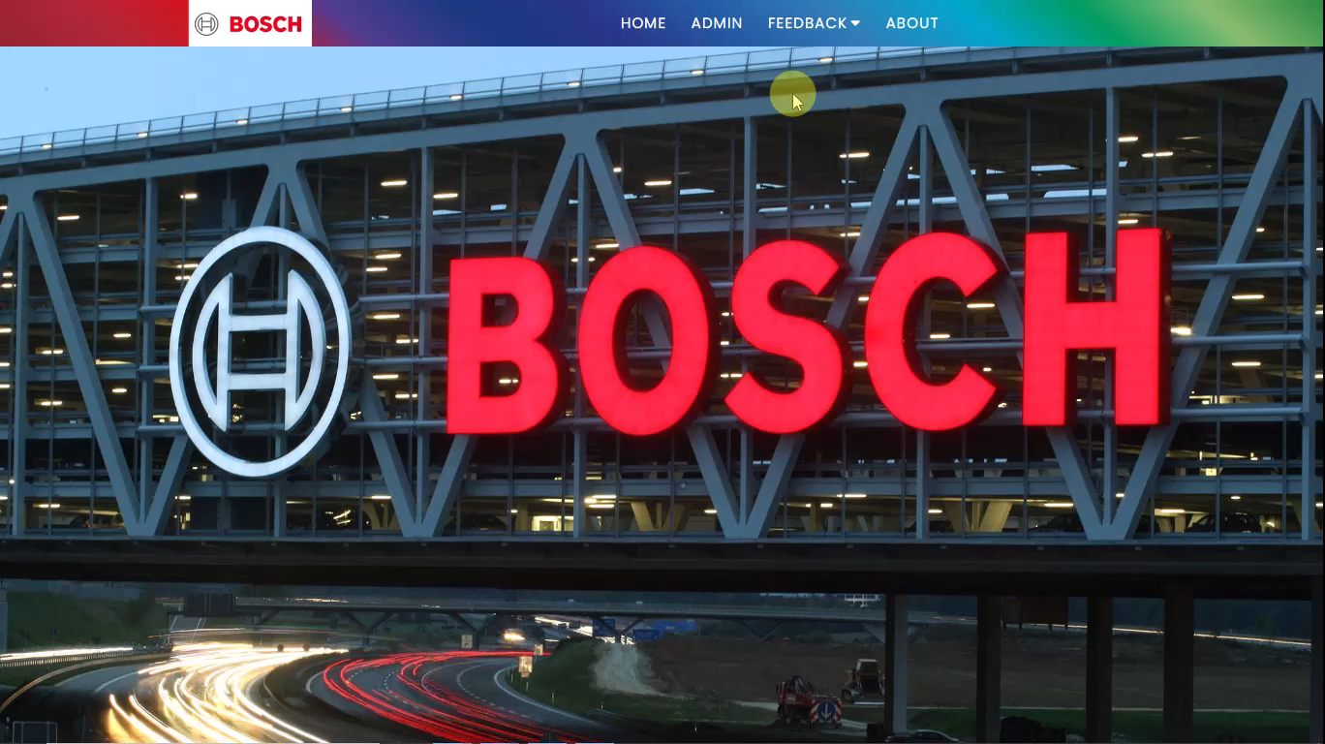
Project demo

Slide 13
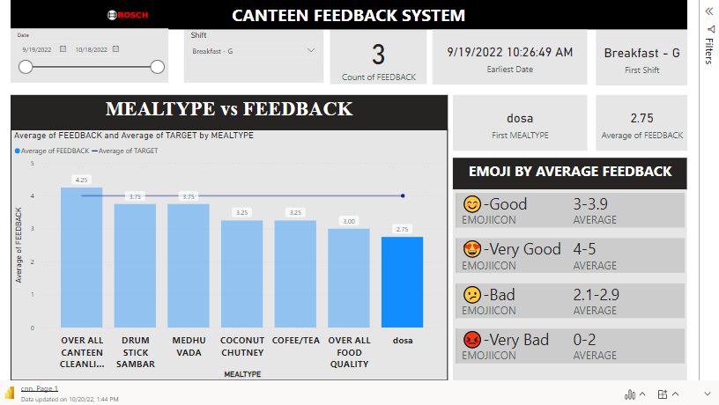

Slide 14
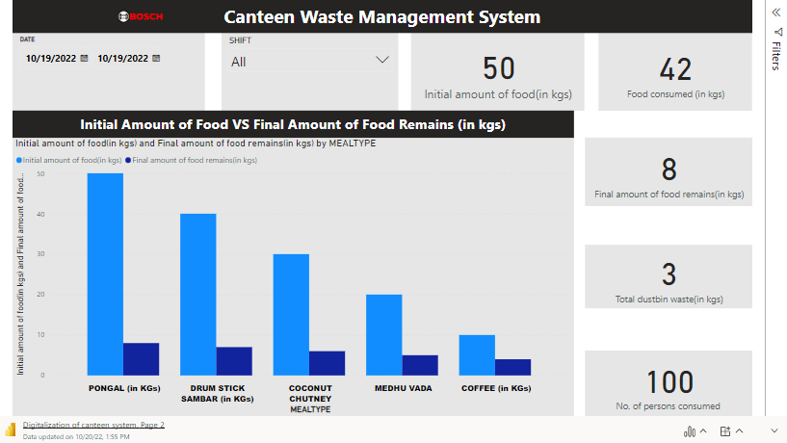

Slide 15
Knowledge Gained:
This project helps us to gain knowledge about various Software and Hardware. Gained Knowledge about, Raspberry pi, its specification and uses. Online Software like Catalytic automation and Push Bot. Front end coding language like HTML(Hyper Text Markup Language)and CSS(Cascading Style Sheets),Backend coding language JS(Java Script). With the help of the coding knowledge, we gained we developed a WEB PAGE for the required system. Explored MS FORMS We learnt how to collect, Analyze, Process the data to get the desired results. Explored Power BI and its specifications, graphs

Slide 16


